Slide 1


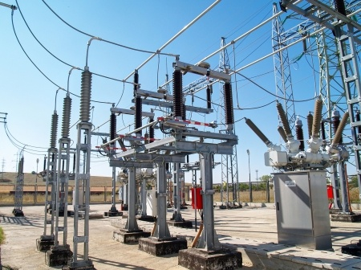

Merced irrigation district
Cost of service and Rate design study (Draft)
Board of Directors Meeting
April 7, 2026

Slide 2
Agenda
Timeline and Summary of Rates Update Components
Cost of Service (COS) Process
Updated Revenue Requirement
Review of COS Study
Recommended Rate Changes
  Base Rates Updates
  Power Cost Adjustment (PCA) Rate and Method Update
  Environmental Charge (EC) Method Update
Customer Class Rate Changes and Impacts

Slide 3
Proposed RateS adoption timeline
Date | Task
4/7/2026 | RATES WORKSHOP: Propose Rates/Methods updates to the Board: Base Rates PCA EC
4/18/2026 | Start of 45-day public notice for final adoption at 6/2/2026 Board meeting
~5/10/2026 | With May bills, include one page information sheet on changes
6/2/2026 | ADOPT NEW RATES/METHODS at BOARD MEETING: New base rates, update PCA and EC methods
7/1/2026 | New Rates/Methods become effective

Slide 4
Summary – Rates update components
Item | Reason | Recommended Timing
Base Rates | Resource Adequacy (RA) prices are the main driver for new rates; align new rates with newest COS | Effective 7/1/2026
PCA method and rate | To better align timing of power supply procurement and power consumption; floor and ceiling rates for rate stability | Method effective 7/1/2026; first rate calculation effective 11/1/2026
EC method | Update to average 36-months of cost to better align with compliance periods; include decarbonization costs as applicable to EC | Method effective 7/1/2026; first rate calculation effective FY28

Slide 5
Summary – Projected Future Rate updates
Item | Reason | Recommended Timing
Time of Use (TOU) Rate functionality and Commercial EV Rate | Better alignment of cost causation with cost signals, however, more complicated. We will monitor performance of these rate updates to determine if there is a need for TOU | After AMI integrations improved and base rate updates are implemented.
Commercial NEM 2 | No Commercial NEM 2 rates; align timing with RES NEM updates and match net billing | After improved AMI integration and TOU
Update Residential NEM 2 | Current rate process with annual true up can be confusing for customers to understand; update to simpler monthly net billing | After improved AMI integration and TOU
Energy Resources Reserves Update | Revisit and review current reserve target amounts | Discussion during FY 2026 to determine if changes are needed

Slide 6
Cost of service – purpose and outcomes
Purpose: Identify all costs of providing electric service and allocate those costs to each customer class in an equitable manner.
Outcome: Determines whether current rates for each rate class are adequately recovering the cost to serve that class and identifies where adjustments may be needed.

Slide 7
Cost of service and rate design process
STEP 1
Determine the revenue requirements of the utility
Revenue Requirement
Unbundle costs by functions and services (power supply, transmission, distribution, etc.)
STEP 2
STEP 3
Classify costs (demand, energy, customer costs, etc.)
Cost Allocation
STEP 4
Allocate cost among customer classes
STEP 5
Design rates
Rate Design

Slide 8
Revenue requirement
Definition: Total costs of providing electric service to customers in various rate classes to be recovered through rate revenue.
  Calculates the cost each customer rate class incurs for electric service
  For each customer rate class, rates should generate revenues equaling the class revenue requirement less any use of (or contribution to) reserves and/or debt for the test year.
  Revenue Requirement is the foundation of a COS study.

Slide 9
Key inputs to the revenue requirement
Merced FY 2026 Budget
Known & Measurable Adjustments
Test Year Revenue Requirement
Fiscal Year (FY) 2026 Budget and adjustments to reflect expected conditions
Capital Improvement Plan (CIP) for FY 2026 – FY 2030 (used 5-year average):
  $8.7 million of CIP in 5-year average
  Distribution and substation enhancements, replacements
  Funded through rate revenues

Slide 10
Test year revenue requirement
Account | Total (COS) | Percentage of Total | FY 2027 Budget
Operations & Maintenance Expenses
Wage & Employee Benefits | $6,746,000 | 8.1% | $7,811,000
Outside Services | $1,895,000 | 2.3% | $1,731,000
Operating Services & Supplies | $2,014,000 | 2.4% | $2,090,000
Public Purpose Program | $1,001,000 | 1.2% | $1,001,000
Cost of Power | $58,838,000 | 70.5% | $59,673,000
Other Expenses | $162,000 | 0.2% | $179,000
Non-Cash Expenses | $5,095,000 | 6.1% | $5,417,000
Subtotal O&M Expenses | $75,751,000 | 90.7% | $77,902,000
Debt Service | $5,836,575 | 7.0% | $5,836,325
Capital Improvement Plan | $8,686,200 | 10.4% | $8,166,000
Non-Operating Revenue | ($6,374,000) | (7.6%) | $(6,573,000)
Other Operating Revenue | ($410,000) | (0.5%) | $(471,000)
Changes to Reserves | $0 | 0.0% | $0
Total Revenue Requirement | $83,489,775 | 100.0% | $84,860,325
Forecasted Revenues | $97,086,868 |  | $93,392,000
Over/(Under) Recovery | $13,597,093 | 14.0%

Slide 11
Cost of service draft results

Slide 12
Functionalization of revenue requirement
Cost of Service Allocation (COSA) by Function
Function | Revenue Requirement | Percentage of Total
Power Supply | $57,436,218 | 68.8%
Transmission | $4,055,327 | 4.9%
Distribution | $19,829,246 | 23.7%
Customer | $2,168,293 | 2.6%
Total | $83,489,775 | 100.0%

Slide 13
classification of revenue requirement
COSA by Classification
Function | Revenue Requirement | Percentage of Total
Customer | $6,088,569 | 7.3%
Energy | $36,867,907 | 44.2%
Demand | $40,533,300 | 48.5%
Direct Assignment | $- | 0.0%
Total | $83,489,775 | 100.0%

Slide 14
Recommended rate/method changes

Slide 15
Rate strategy – recommendation
Update rates in line with COS
  Increase base rates and reduce PCA: Net system average – 9% cost reduction
  Maintain general structure of current rates (i.e., not adding or removing tiers)
  Increase Demand Charges where applicable to align Fixed Cost recovery in line with COS
  Updates to Residential NEM 2.0: Reduce customer charge, add demand charge
Update PCA calculation method to include historical and forecasted power supply costs
  Set PCA at $0.01/kWh
Update EC – to be based on 36 months forecast of costs, to roughly align with compliance periods
  Keep EC at current rate $0.00407/kWh until next scheduled calculation

Slide 16
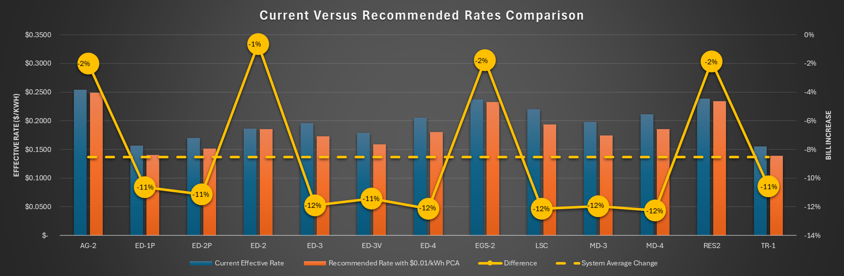
Rate strategy – recommendation

Slide 17
Current ec Method
Intent:
To recover costs associated with Renewable Portfolio Standard (RPS), Greenhouse Gas (GHG), and other applicable laws/regulations related to renewable energy and emissions reductions
The EC is a direct pass-through on each customer’s bill
Current Method:
Budgeted Fiscal Year – Net RPS and GHG costs divided by forecasted energy sales to determine EC
Reconciliation of actual cost and budgeted costs occurs in the following year EC calculation

Slide 18
Current EC Method – Key observations
Current EC method calculates 12 months of environmental costs – this differs from compliance periods, which are typically based on 36 months of projected costs
RPS Compliance Period | Begins | Ends | Duration (Years)
1 | 2011 | 2013 | 3
2 | 2014 | 2016 | 3
3 | 2017 | 2020 | 4
4 | 2021 | 2024 | 4
5 | 2025 | 2027 | 3
6 | 2028 | 2030 | 3
GHG Compliance Period | Begins | Ends | Duration (Years)
1 | 2013 | 2014 | 2
2 | 2015 | 2017 | 3
3 | 2018 | 2020 | 3
4 | 2021 | 2023 | 3
5 | 2024 | 2026 | 3
6 | 2027 | 2029 | 3
7 | 2030 | 2032 | 3

Slide 19
proposed ec changes
Current | Proposed | Impact
12 months projected costs | 36 months projected costs | Spreads out compliance period costs more evenly
N/A | Add inclusion of emissions reduction technology | Proactively address cost allocation for this kind of procurement
Reconcile with net costs | Reconcile with net costs, but allow for use of estimates | Estimates of net costs may be applicable if more complicated resource acquisitions are made in the future

Slide 20
Current PCA Method
Intent:
To recover costs associated with fluctuations in net power supply costs over time
PCA is a critical element considered by bond ratings companies (e.g., Fitch, Moodys, and S&P) when calculating their ratings
Proper use of a PCA will contribute to increased credit ratings and reduced borrowing costs
Current Method:
Compares the most recent 12 months of power supply costs to power supply revenues from rates
The difference between the two totals is used as the PCA rate, in $/kWh.

Slide 21
Current PCA Method – Key observations
Currently the PCA only considers historical power supply costs
This can be confusing for customers if spot or forward prices deviate significantly from the prior 12 months (e.g., PCA going up while current prices are going down)
Power supply costs are incurred in both the forward and spot markets, but this isn’t considered when only including historical expenses in the PCA
  This leaves room for better cost causation alignment

Slide 22
Proposed PCA Method Changes
Change timeframe evaluated from 12 months of history to 6 months of history and 12-month forecast of power supply costs vs projected revenues
Set minimum and maximum PCA rates of -$0.01/kWh and $0.05/kWh, respectively
  To the extent actual power supply costs would result in a PCA outside of these limits, the difference may be deferred and incorporated into future PCA calculations

Slide 23
Proposed PCA Method Changes
Current | Proposed | Impact
12 months historical expense | 6 months historical expense | Better align timing of costs with use and procurement of resources
12 months revenues based on budget rate | 6 months historical revenue | Better align timing of costs with use and procurement of resources
No forward-looking component | 12 months projected expense and revenue | Better align timing of costs with use and procurement of resources
No minimum rate | Minimum PCA of -$0.01/kWh | Increase in reserves if significant reduction in power supply costs
No maximum rate | Maximum PCA of $0.05/kWh | Decrease in reserves if significant increase in power supply costs, can be a trigger to start new COS/Rates
Summary - full pass through of power supply expenses, but room to improve alignment between timing of costs and expenses | Summary - near full pass through of power supply expenses, with stabilization from min and max rates, better timing between costs incurred by MID and services provided by those costs

Slide 24
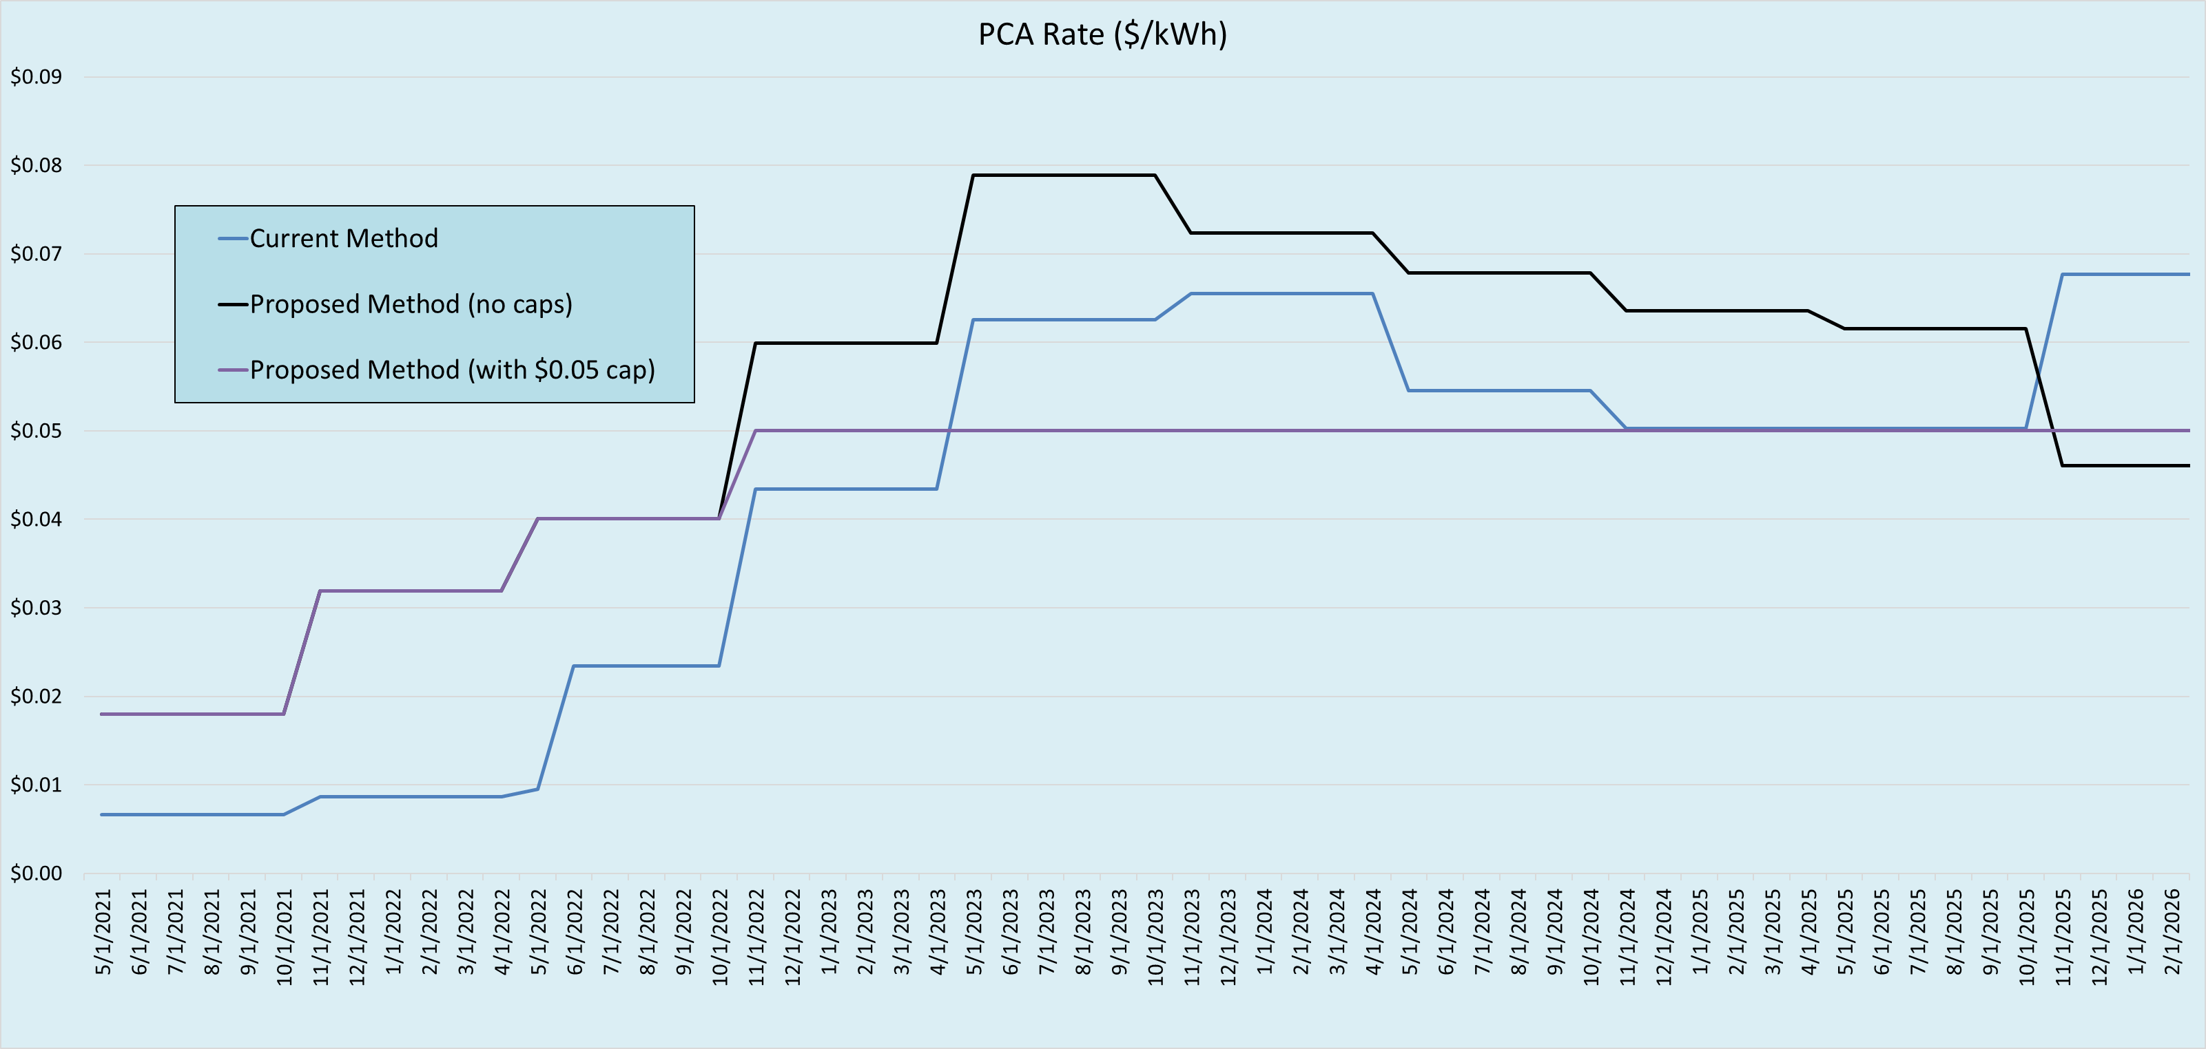
Proposed PCA Method Rate comparison

Slide 25
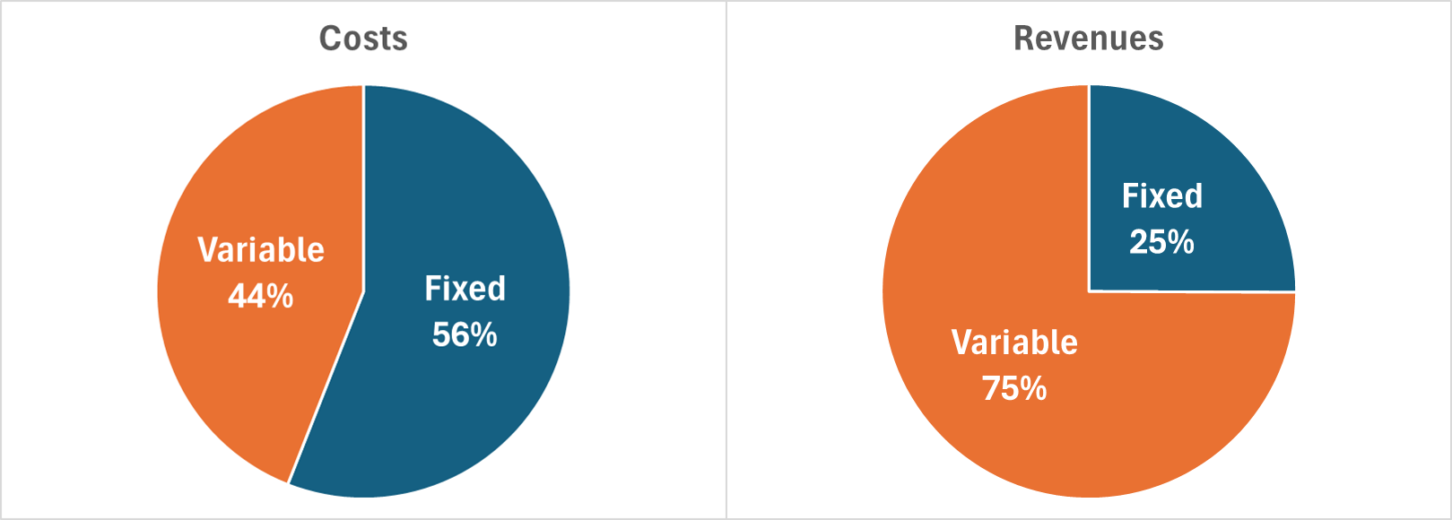
Fixed cost recovery – current

Slide 26
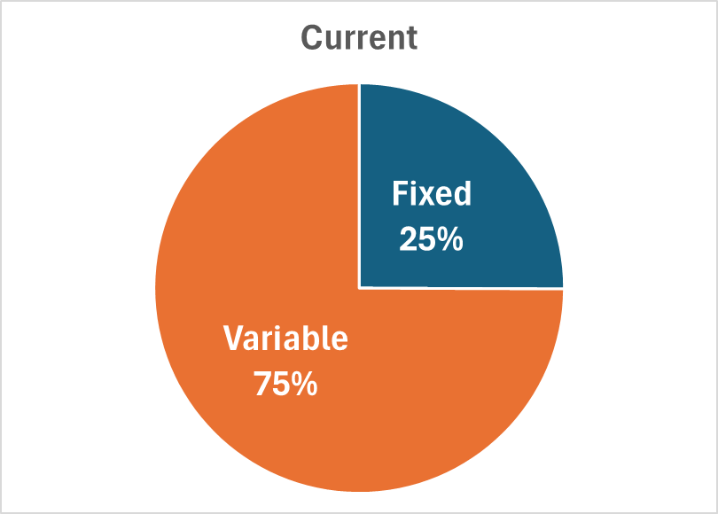
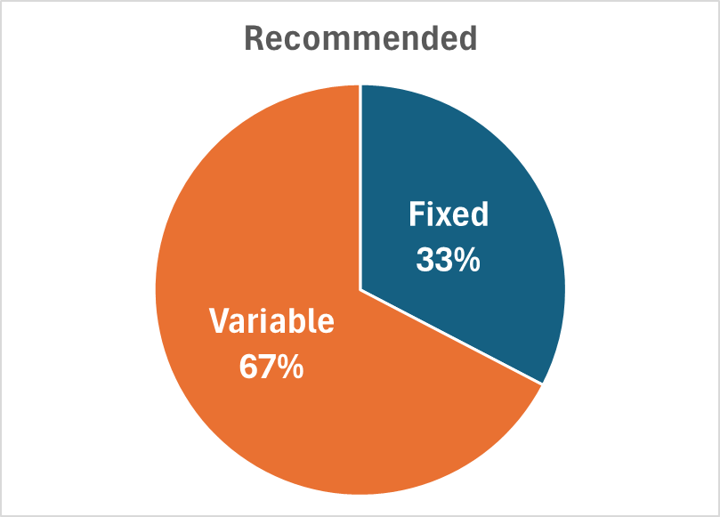
Fixed cost recovery – recommended rates

Slide 27
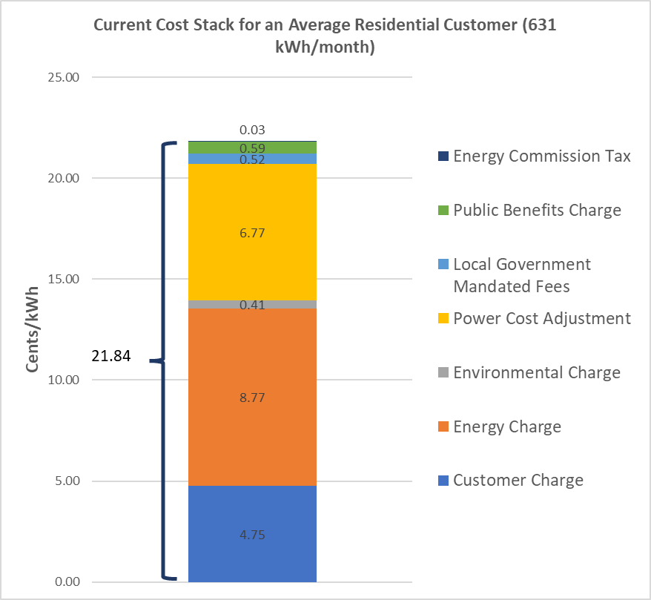
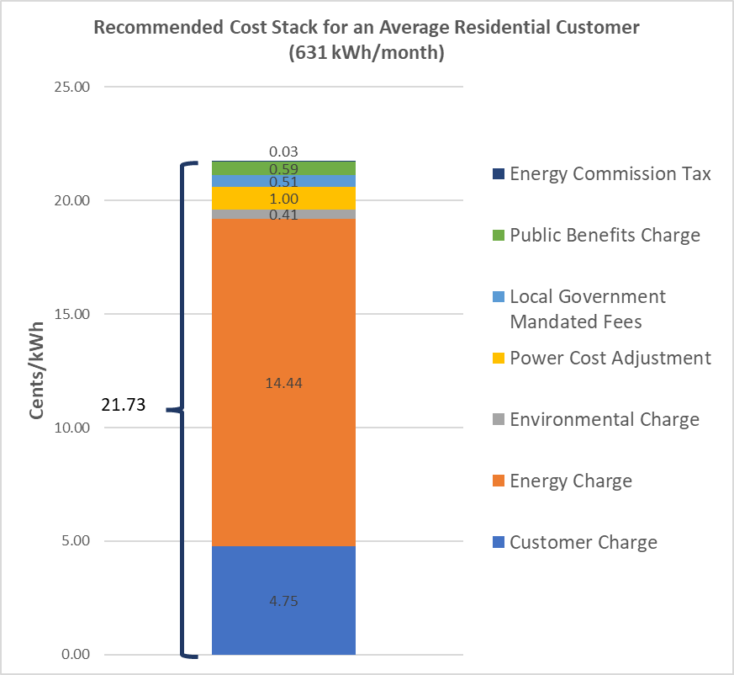
Rate strategy – Example

Slide 28
Recommended rates

Slide 29
Cost of service and draft rates
RES-2 Residential General Service
Rate Unit | Unit Results |  |  | Recommended Rate | Change
Rate Unit | COS |  | Current Rate
Customer Charge ($/Month) | $26.34 |  | $30.00 | $30.00 | $-
Energy Charge ($/kWh) | $0.0733 | Tier 1 | $0.0817 | $0.1388 | $0.0571
 |  | Tier 2 | $0.2085 | $0.2556 | $0.0471
Demand Charge ($/kW) | $20.34 |  | $ - | $ - | $-
EC Adjustment ($/kWh) | N/A |  | $0.004070 | $0.004070 | $-
PCA Adjustment ($/kWh) | N/A |  | $0.067655 | $0.010000 | $(0.057655)
Average Rate ($/kWh) | $0.2212 |  | $0.2387 | $0.2342 | $(0.0045)

Slide 30
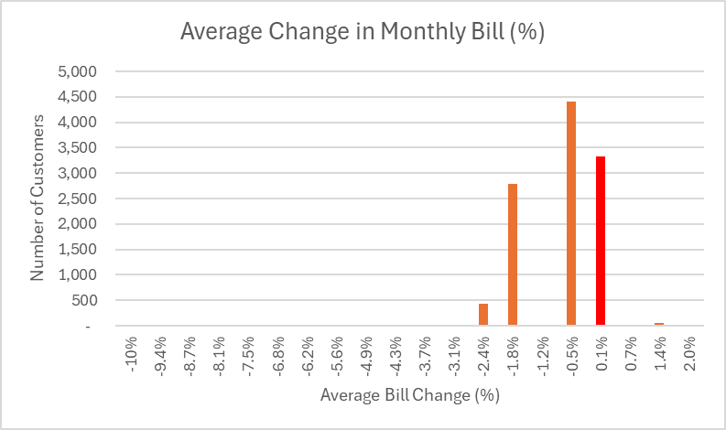
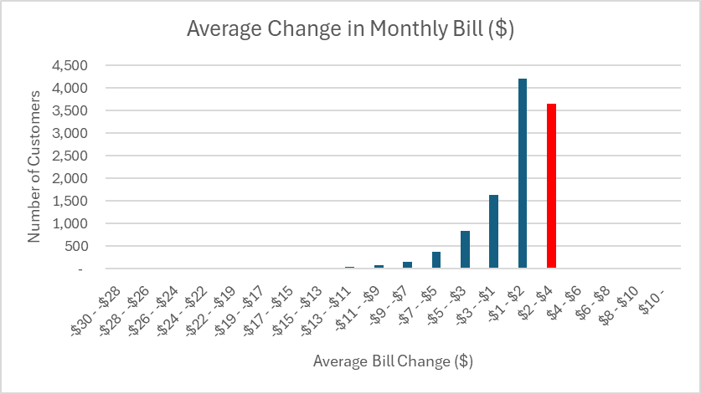
Cost of service analysis unit results res2 – residential general service

Slide 31
Average residential bill
Average Residential Bill (Summer - 747 kWh/Mo., Winter – 515 kWh/Mo.)
Rate Unit | Current Rate | Recommended Rate | Change
Customer Charge ($/Month) | $30.00 | $30.00 | $0.00
Energy Charge
Tier 1 ($/kWh) | $0.0817 | $0.1388 | $0.0571
Tier 2 ($/kWh) | $0.2085 | $0.2556 | $0.0471
Adjustments
EC Adjustment ($/kWh) | $0.004070 | $0.00407 | $-
PCA Adjustment ($/kWh) | $0.067655 | $0.01000 | $(0.057655)
Total Average Bill
Summer | $156.71 | $155.95 | $(0.76)
Winter | $118.87 | $118.27 | $(0.60)

Slide 32
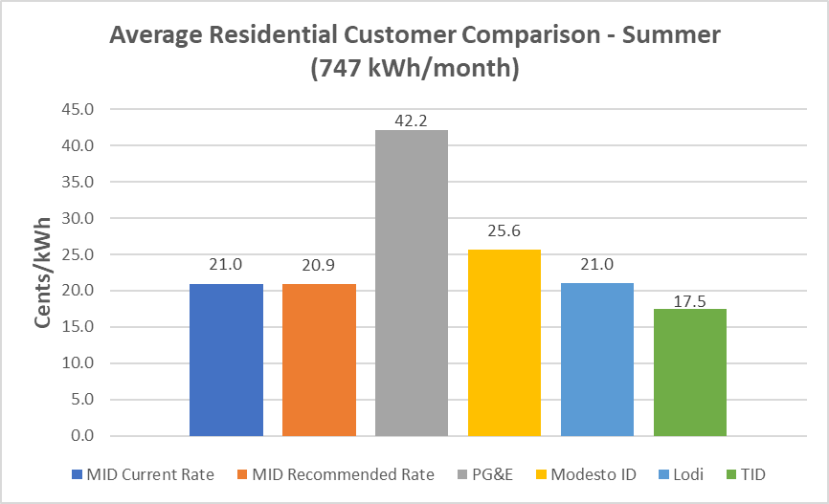
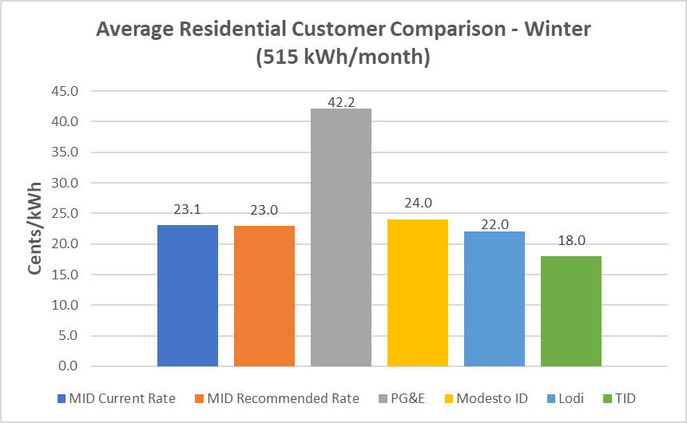
Average residential bill – benchmarking to PG&E, Modesto ID, Lodi and turlock id

Slide 33
RES-2 Nem 2.0 – Residential Net energy Metering rate update
RES-2 NEM 2.0 Rate
 | Unit Results |  |  | Recommended Rate | Change
 | COS |  | Current
Customer Charge ($/Month) | $26.34 |  | $65.00 | $30.00 | $(35.00)
Usage Energy Charge ($/kWh) | $0.07334 |  | $0.06080 | $0.1388 | $0.078
Demand Charge ($/kW) | $20.34 | Summer | $- | $8.19 | $8.19
 |  | Winter | $- | $5.19 | $5.19
PCA ($/kWh) | $0.0000 |  | $0.067655 | $0.0100 | $(0.057655)
Excess Generation Credit ($/kWh) | $0.07334 |  | $0.04950 | $0.04950 | $-

Slide 34
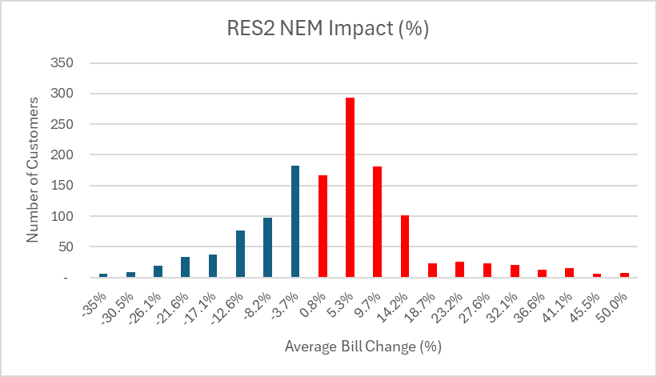
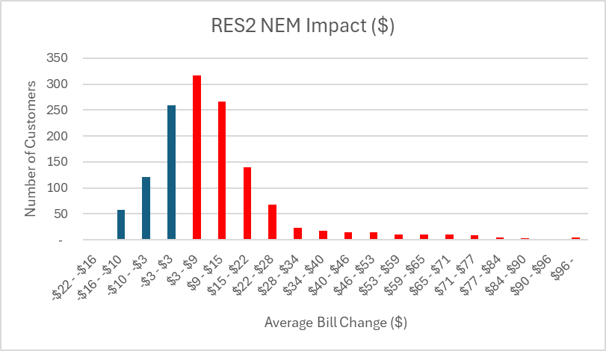
Cost of service analysis unit results res-2 NEM 2.0 Service

Slide 35
Proposed Next steps
Date | Task
4/18/2026 | Start of 45-day window for final rate/method adoption at 6/2/2026 Board meeting
~5/10/2026 | With May bills, include information sheet on proposed changes
6/2/2026 | ADOPT NEW RATES/METHODS at BOARD MEETING: New base rates, update PCA rate and method, and update EC method
7/1/2026 | New Rates/Methods become effective

Slide 36
Questions?

Slide 37
Supplemental Slides

Slide 38
Recommended rates for all classes

Slide 39
Average residential bill – benchmarking to PG&E and Modesto ID
Average Residential Bill Comparison
Rate Unit | Current Rate | Recommended Rate
MID Average Bills
Summer | $156.71 | $155.95
Winter | $118.87 | $118.27
PG&E Average Bills¹
Summer | $315.09
Winter | $217.23
Difference
Summer | $(158.38) | $(159.14)
Winter | $(98.36) | $(98.96)
Notes: 1. As of 09/01/25 rates
Average Residential Bill Comparison
Rate Unit | Current Rate | Recommended Rate
MID Average Bills
Summer | $156.71 | $155.95
Winter | $118.87 | $118.27
Modesto ID Average Bills
Summer | $191.48
Winter | $123.83
Difference
Summer | $(34.77) | $(35.53)
Winter | $(4.96) | $(5.56)

Slide 40
Average residential bill – benchmarking to TID and lodi
Average Residential Bill Comparison
Rate Unit | Current Rate | Recommended Rate
MID Average Bills
Summer | $156.71 | $155.95
Winter | $118.87 | $118.27
TID Average Bills
Summer | $130.92
Winter | $92.64
Difference
Summer | $25.79 | $25.03
Winter | $26.23 | $25.63
Average Residential Bill Comparison
Rate Unit | Current Rate | Recommended Rate
MID Average Bills
Summer | $156.71 | $155.95
Winter | $118.87 | $118.27
Lodi Average Bills
Summer | $156.77
Winter | $113.22
Difference
Summer | $(0.06) | $(0.82)
Winter | $5.65 | $5.05

Slide 41
Cost of service and draft rates
AG-2 – Agricultural Demand General Service
Rate Unit | Unit Results |  |  | Recommended Rate | Change
Rate Unit | COS |  | Current Rate
Customer Charge ($/Month) | $123.34 |  | $100.00 | $100.00 | $-
Energy Charge ($/kWh) | $0.07334 | Summer | $0.0817 | $0.1343 | $0.0526
 |  | Winter | $0.0817 | $0.1343 | $0.0526
Demand Charge ($/kW) | $20.68 | Summer | $7.50 | $7.50 | $-
 |  | Winter | $4.50 | $4.50 | $-
EC Adjustment ($/kWh) | N/A |  | $0.004070 | $0.004070 | $-
PCA Adjustment ($/kWh) | N/A |  | $0.067655 | $0.0100 | $(0.057655)
Average Rate ($/kWh) | $0.2834 |  | $0.2543 | $0.2492 | $0.0051

Slide 42
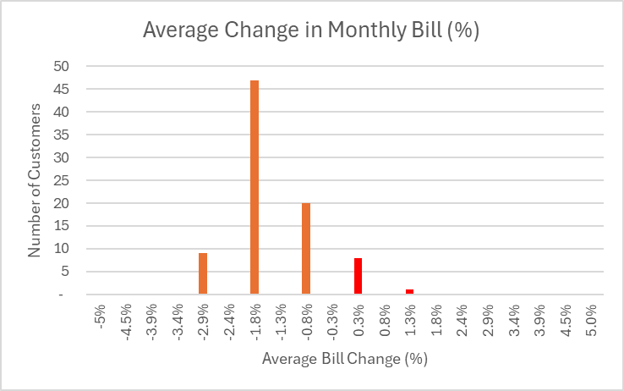
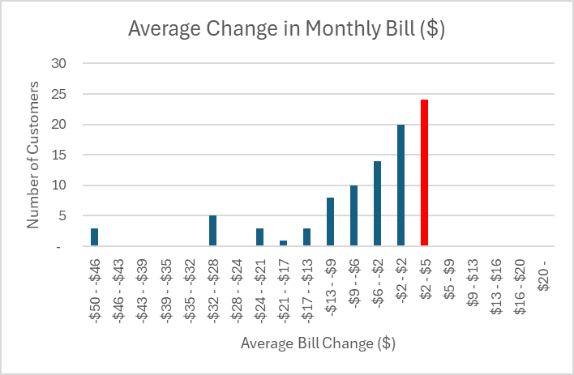
Cost of service analysis unit results
AG-2 – AGRICULTURAL DEMAND general service

Slide 43
Cost of service and draft rates
TR-1 Large Demand Transmission Service
Rate Unit | Unit Results |  |  | Recommended Rate | Change
Rate Unit | COS |  | Current Rate
Customer Charge ($/Month) | $946.21 |  | $1,000.00 | $1,000.00 | $-
Energy Charge ($/kWh) | $0.0708 | Summer | $0.0610 | $0.08674 | $0.02574
 |  | Winter | $0.0610 | $0.08674 | $0.02574
Demand Charge ($/kW) | $19.72 | Summer | $10.00 | $17.00 | $7.00
 |  | Winter | $10.00 | $17.00 | $7.00
EC Adjustment ($/kWh) | N/A |  | $0.004070 | $0.00407 | $-
PCA Adjustment ($/kWh) | N/A |  | $0.067655 | $0.01000 | $(0.057655)
Average Rate ($/kWh) | $0.1149 |  | $0.1554 | $0.1389 | $(0.0165)

Slide 44
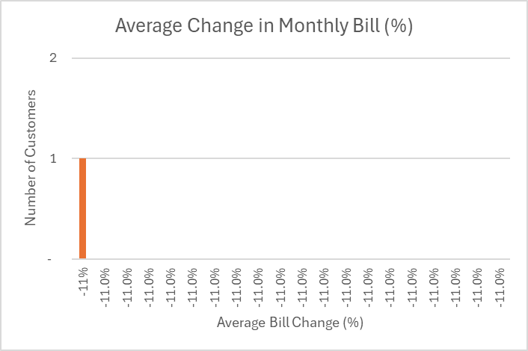
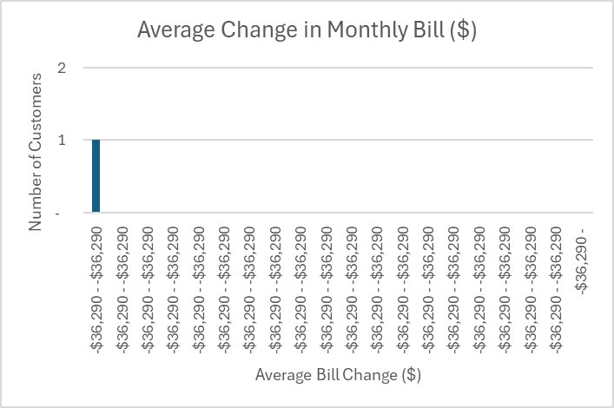
Cost of service analysis unit results
TR-1 – LARGE DEMAND TRANSMISSION service

Slide 45
Cost of service and draft rates
ED-1P Large Demand General Service
Rate Unit | Unit Results |  |  | Recommended Rate | Change
Rate Unit | COS |  | Current Rate
Customer Charge ($/Month) | $2,398.20 |  | $1,100.00 | $1,100.00 | $-
Energy Charge ($/kWh) | $0.07206 | Summer | $0.0486 | $0.08338 | $0.03478
 |  | Winter | $0.0486 | $0.08338 | $0.03478
Demand Charge ($/kW) | $32.75 | Summer | $19.20 | $22.50 | $3.30
 |  | Winter | $19.20 | $22.50 | $3.30
EC Adjustment ($/kWh) | N/A |  | $0.004070 | $0.00407 | $-
PCA Adjustment ($/kWh) | N/A |  | $0.067655 | $0.01000 | $(0.057655)
Average Rate ($/kWh) | $0.1343 |  | $0.1568 | $0.1401 | $(0.0167)

Slide 46
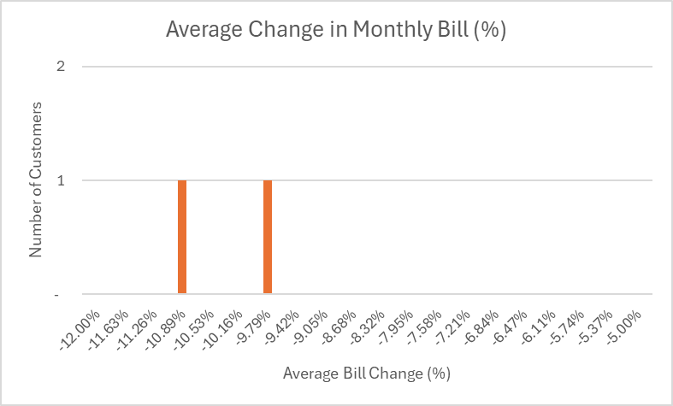
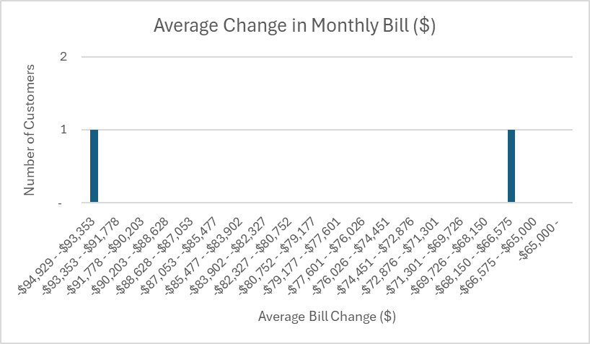
Cost of service analysis unit results
ED-1P – LARGE DEMAND GENERAL service

Slide 47
Cost of service and draft rates
ED-2 Large Demand General Service
Rate Unit | Unit Results |  |  | Recommended Rate | Change
Rate Unit | COS |  | Current Rate
Customer Charge ($/Month) | $2,151.97 |  | $1,100.00 | $1,100.00 | $-
Energy Charge ($/kWh) | $0.07232 | Summer | $0.0667 | $0.10898 | $0.04228
 |  | Winter | $0.0667 | $0.10898 | $0.04228
Demand Charge ($/kW) | $33.12 | Summer | $20.00 | $25.00 | $5.00
 |  | Winter | $10.00 | $15.00 | $5.00
EC Adjustment ($/kWh) | N/A |  | $0.004070 | $0.00407 | $-
PCA Adjustment ($/kWh) | N/A |  | $0.067655 | $0.01000 | $(0.057655)
Average Rate ($/kWh) | $0.1741 |  | $0.1865 | $0.1853 | $(0.0012)

Slide 48
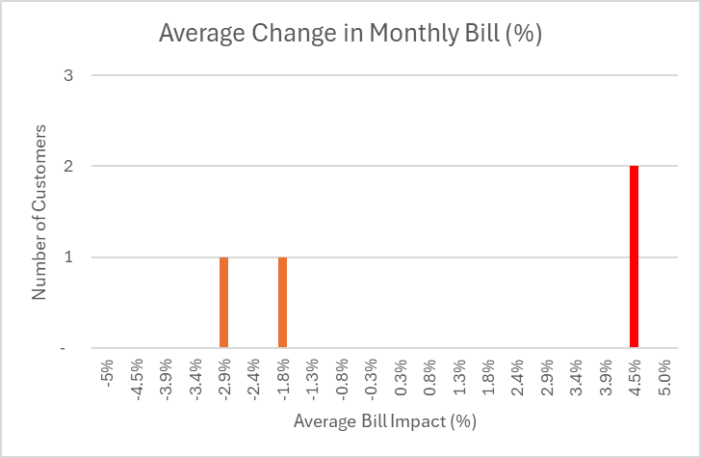
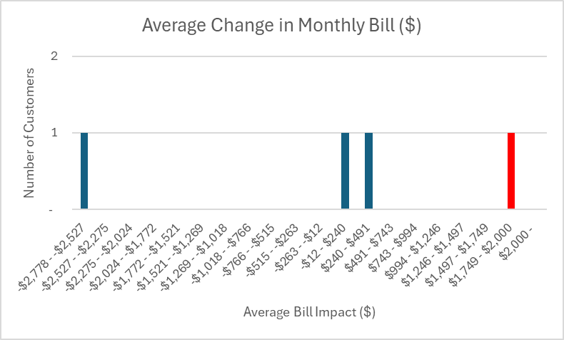
Cost of service analysis unit results
ED-2 – LARGE DEMAND GENERAL service

Slide 49
Cost of service and draft rates
ED-2P Large Primary Demand Service
Rate Unit | Unit Results |  |  | Recommended Rate | Change
Rate Unit | COS |  | Current Rate
Customer Charge ($/Month) | $2,151.97 |  | $1,535.00 | $1,535.00 | $-
Energy Charge ($/kWh) | $0.07232 | Summer | $0.0608 | $0.08921 | $0.02841
 |  | Winter | $0.0608 | $0.08921 | $0.02841
Demand Charge ($/kW) | $33.12 | Summer | $27.00 | $33.00 | $6.00
 |  | Winter | $10.00 | $15.00 | $5.00
EC Adjustment ($/kWh) | N/A |  | $0.004070 | $0.00407 | $-
PCA Adjustment ($/kWh) | N/A |  | $0.067655 | $0.01000 | $(0.057655)
Average Rate ($/kWh) | $0.1364 |  | $0.1701 | $0.1512 | $(0.0189)

Slide 50
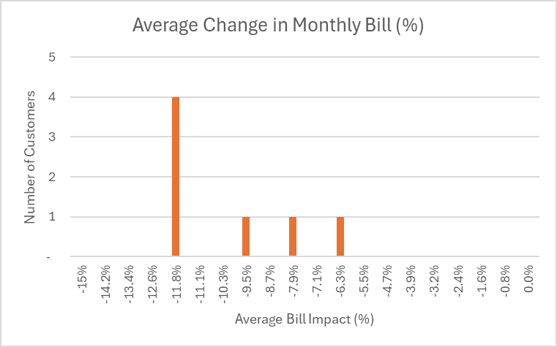
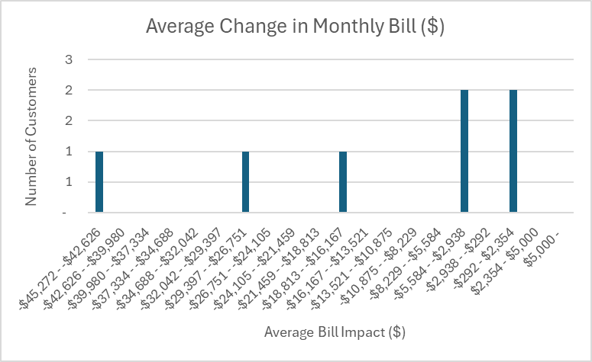
Cost of service analysis unit results
ED-2P – LARGE PRIMARY DEMAND service

Slide 51
Cost of service and draft rates
ED-3 Medium Demand General Service
Rate Unit | Unit Results |  |  | Recommended Rate | Change
Rate Unit | COS |  | Current Rate
Customer Charge ($/Month) | $454.38 |  | $350.00 | $350.00 | $-
Energy Charge ($/kWh) | $0.07334 | Summer | $0.0678 | $0.08807 | $0.02027
 |  | Winter | $0.0678 | $0.08807 | $0.02027
Demand Charge ($/kW) | $30.64 | Summer | $28.00 | $33.00 | $5.00
 |  | Winter | $10.00 | $15.00 | $5.00
EC Adjustment ($/kWh) | N/A |  | $0.004070 | $0.00407 | $-
PCA Adjustment ($/kWh) | N/A |  | $0.067655 | $0.01000 | $(0.057655)
Average Rate ($/kWh) | $0.1618 |  | $0.1959 | $0.1726 | $(0.0233)

Slide 52
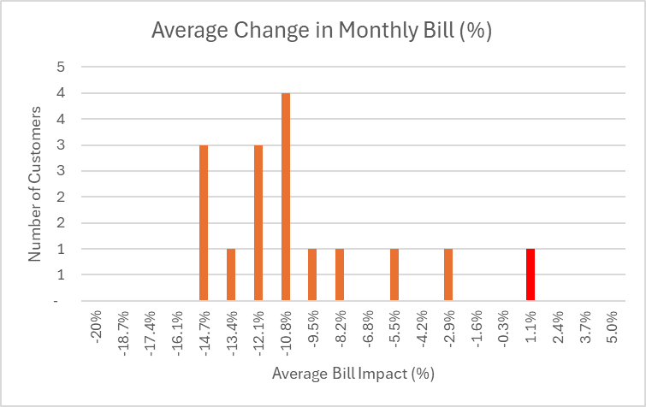
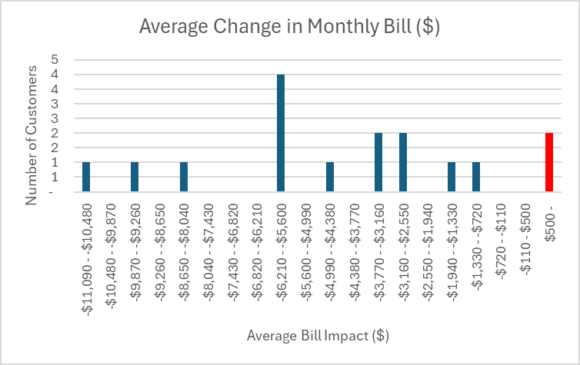
Cost of service analysis unit results
ED-3 – MEDIUM demand general service

Slide 53
Cost of service and draft rates
ED-3V Medium Demand General Service (Voluntary)
Rate Unit | Unit Results |  |  | Recommended Rate | Change
Rate Unit | COS |  | Current Rate
Customer Charge ($/Month) | $178.06 |  | $200.00 | $200.00 | $-
Energy Charge ($/kWh) | $0.07334 | Summer | $0.0699 | $0.0991 | $0.0292
 |  | Winter | $0.0699 | $0.0991 | $0.0292
Demand Charge ($/kW) | $34.74 | Summer | $30.00 | $32.00 | $2.00
 |  | Winter | $10.00 | $17.50 | $7.50
EC Adjustment ($/kWh) | N/A |  | $0.004070 | $0.00407 | $-
PCA Adjustment ($/kWh) | N/A |  | $0.067655 | $0.01000 | $(0.057655)
Average Rate ($/kWh) | $0.1353 |  | $0.1791 | $0.1586 | $(0.0205)

Slide 54
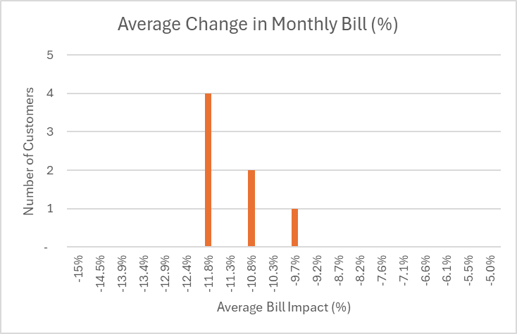
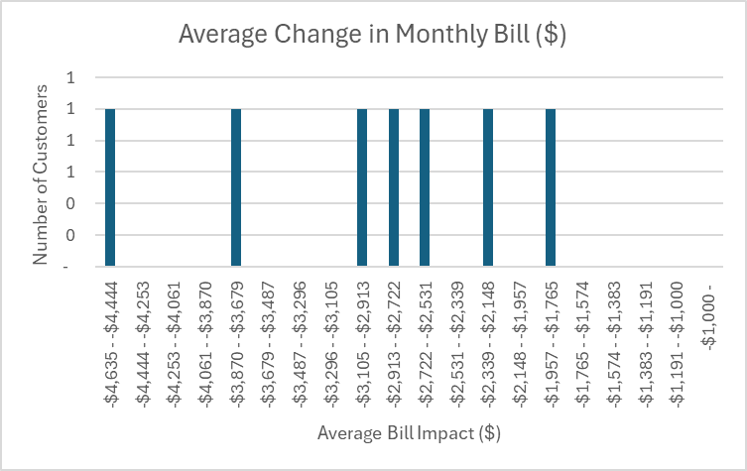
Cost of service analysis unit results
ED-3V – MEDIUM demand general service (VOLUNTARY)

Slide 55
Cost of service and draft rates
ED-4 Small Demand General Service
Rate Unit | Unit Results |  |  | Recommended Rate | Change
Rate Unit | COS |  | Current Rate
Customer Charge ($/Month) | $152.87 |  | $130.00 | $130.00 | $-
Energy Charge ($/kWh) | $0.07334 | Summer | $0.0704 | $0.08847 | $0.01807
 |  | Winter | $0.0704 | $0.08847 | $0.01807
Demand Charge ($/kW) | $28.82 | Summer | $25.00 | $27.50 | $2.50
 |  | Winter | $10.00 | $17.50 | $7.50
EC Adjustment ($/kWh) | N/A |  | $0.004070 | $0.00407 | $-
PCA Adjustment ($/kWh) | N/A |  | $0.067655 | $0.01000 | $(0.057655)
Average Rate ($/kWh) | $0.1700 |  | $0.2051 | $0.1802 | $(0.0249)

Slide 56
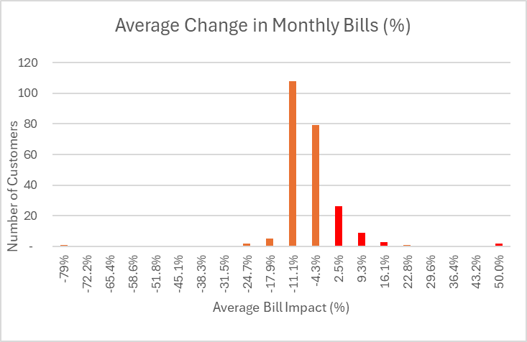
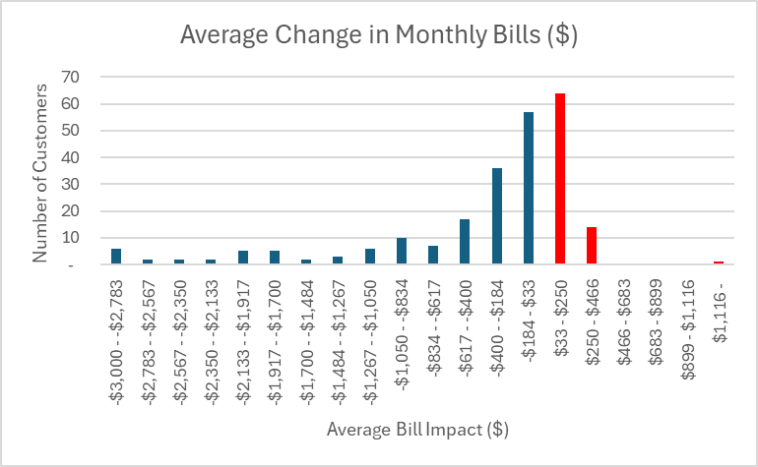
Cost of service analysis unit results
ED-4 – small demand general service

Slide 57
Cost of service and draft rates
EGS-2 Small Commercial and Industrial General Service
Rate Unit | Unit Results |  |  | Recommended Rate | Change
Rate Unit | COS |  | Current Rate
Customer Charge ($/Month)
Single Phase | $71.27 |  | $55.00 | $55.00 | $-
Three Phase | $71.27 |  | $82.50 | $82.50 | $-
Energy Charge ($/kWh) | $0.07334 | Summer | $0.1125 | $0.1659 | $0.0534
 |  | Winter | $0.1125 | $0.1659 | $0.0534
Demand Charge ($/kW) | $25.02 | Summer | $ - | $ -
 |  | Winter | $ - | $ -
EC Adjustment ($/kWh) | N/A |  | $0.004070 | $0.00407 | $-
PCA Adjustment ($/kWh) | N/A |  | $0.067655 | $0.01000 | $(0.057655)
Average Rate ($/kWh) | $0.2247 |  | $0.2369 | $0.2327 | $(0.0042)

Slide 58
Cost of service and draft rates
MD-3 Municipal & Non-Profit Medium Demand General Service
Rate Unit | Unit Results |  |  | Recommended Rate | Change
Rate Unit | COS |  | Current Rate
Customer Charge ($/Month) | $661.62 |  | $350.00 | $350.00 | $-
Energy Charge ($/kWh) | $0.07334 | Summer | $0.0628 | $0.07978 | $0.01709
 |  | Winter | $0.0628 | $0.07978 | $0.01709
Demand Charge ($/kW) | $35.27 | Summer | $26.00 | $31.00 | $5.00
 |  | Winter | $10.00 | $15.00 | $5.00
EC Adjustment ($/kWh) | N/A |  | $0.004070 | $0.00407 | $-
PCA Adjustment ($/kWh) | N/A |  | $0.067655 | $0.01000 | $(0.057655)
Average Rate ($/kWh) | $0.2001 |  | $0.1981 | $0.1744 | $(0.0237)

Slide 59
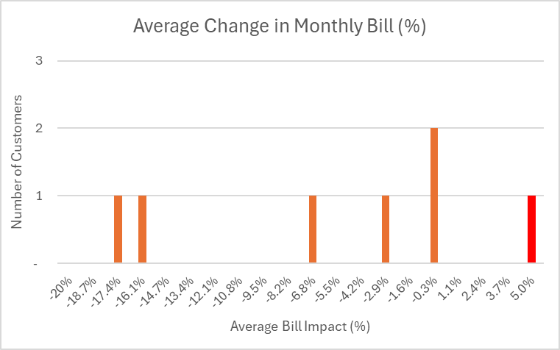
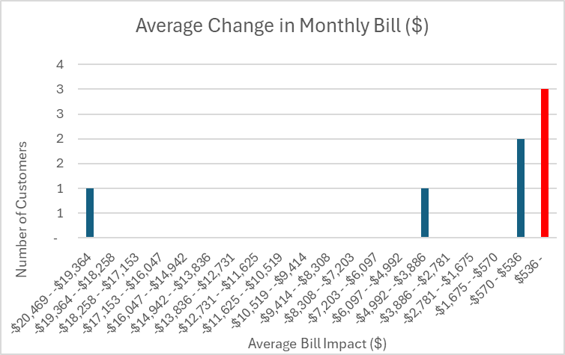
Cost of service analysis unit results md-3 municipal & non-profit MEDIUM DEMAND service

Slide 60
Cost of service and draft rates
MD-4 Municipal & Non-Profit Small Demand General Service
Rate Unit | Unit Results |  |  | Recommended Rate | Change
Rate Unit | COS |  | Current Rate
Customer Charge ($/Month) | $152.87 |  | $130.00 | $130.00 | $-
Energy Charge ($/kWh) | $0.07334 | Summer | $0.0663 | $0.08161 | $0.01531
 |  | Winter | $0.0663 | $0.08161 | $0.01531
Demand Charge ($/kW) | $25.20 | Summer | $22.50 | $25.00 | $2.50
 |  | Winter | $9.00 | $15.00 | $6.00
EC Adjustment ($/kWh) | N/A |  | $0.004070 | $0.00407 | $-
PCA Adjustment ($/kWh) | N/A |  | $0.067655 | $0.01000 | $(0.057655)
Average Rate ($/kWh) | $0.1825 |  | $0.2111 | $0.1852 | $(0.0259)

Slide 61
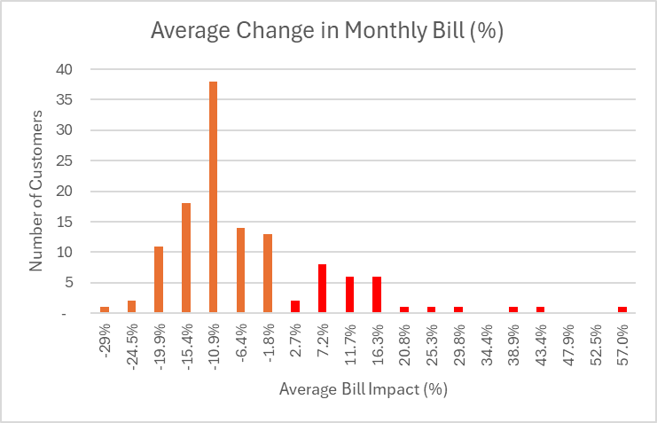
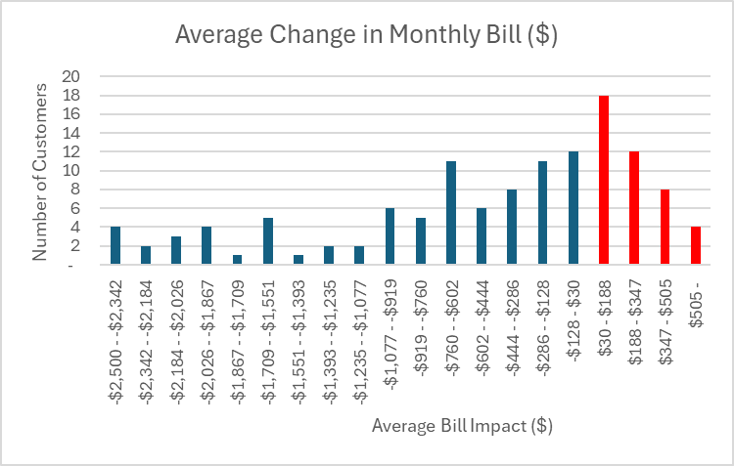
Cost of service analysis unit results md-4 municipal & non-profit small DEMAND service

